Slide 1
Method Invocation Pattern In JavaScript
Sandeep Kumawat
Taazaa

Slide 2
Types of Method Invocation Pattern in JavaScript
Function Invocation Pattern
Method Invocation Pattern
Invocation
Pattern
Constructor Invocation Pattern
Indirect Invocation Pattern

Slide 3

Function Invocation Pattern
When Function is called as Function.
The value of 'this' here is Global Object like Nodejs and in Browser window is global object.

Slide 4

Constructor Invocation Pattern
When call a function with 'new'
The value of 'this' is newly created object.
'return' has no value here.

Slide 5

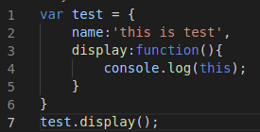
Method Invocation Pattern
Invoked using dot ('.') operator on object.
The value of 'this' depends on the object before dot ('.') operator.

Slide 6
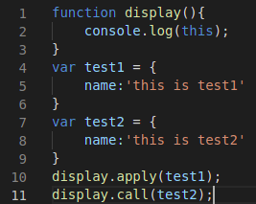
Indirect Invocation Pattern
This pattern can achieve by three ways-
Apply() method
Bind() method
Call() method
We pass objects indirectly in other object function. This value depends on manually passed Value.

Slide 7
Thank You

